Slide 1
Reinforcement Learning for Robotics
Hands-on Project
Mun Seng Phoon
Zhaobo Xu

Slide 2
Introduction

Slide 3
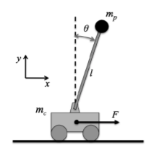
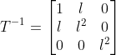
Introduction
environment: Cart Pole Workbench
parameters
goal: hold the pole upward
approaches: Optimal Control & Deep RL
reward:
Cart Mass | 0.5 kg
Pole Mass | 0.5 kg
Pole length | 0.6 kg
Gravitational Const. | 9.8 m/s^2

Slide 4
Iterative Linear Quadratic Regulator

Slide 5
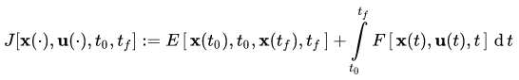
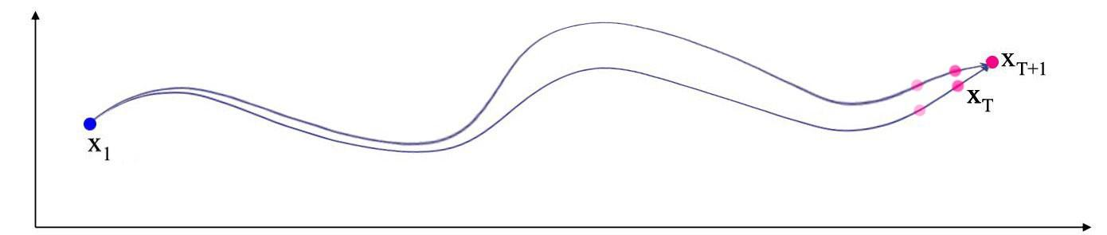
Optimal Control: Idea
optimizing the trajectory cost functional w.r.t a path of control signal u.
use dynamic programming

Slide 6
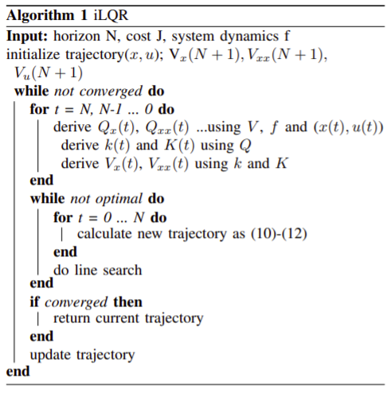
iLQR: Algorithm
cost: quadratic functions.
perturbation and cost change Q(dx, du)
backward path:
given a trajectory, solve for policy change
forward path
given the policy change, derive the new
trajectory
evaluate and iterate

Slide 7
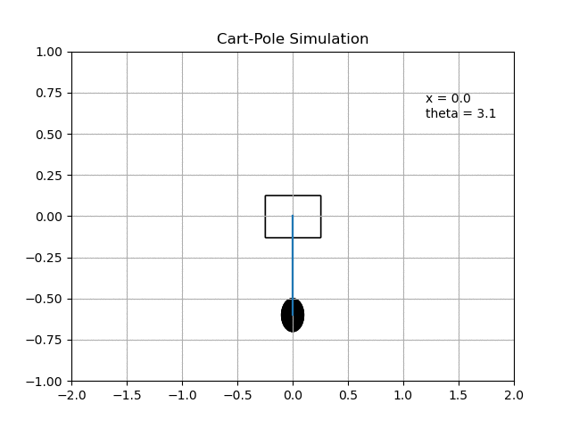
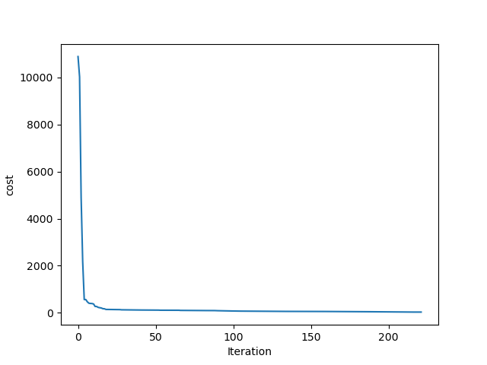
Results

Slide 8
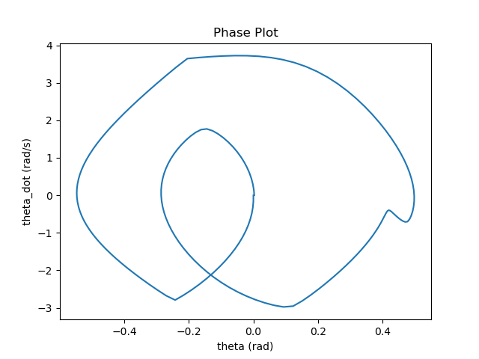
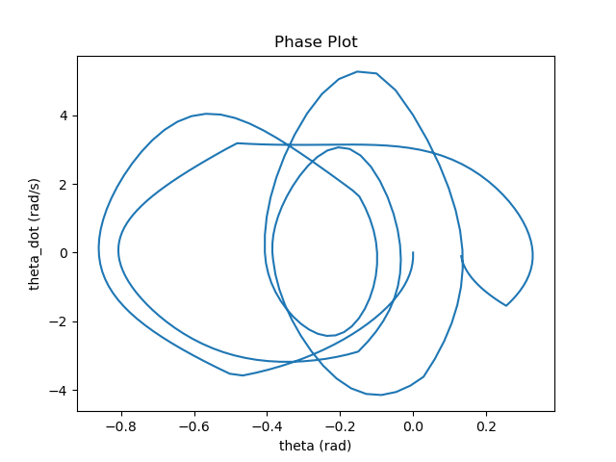
Results
horizon: 180, episodes: about 200
if horizon too large:
regularization: non PD hessian problems

Slide 9
Deep Q-Learning Network

Slide 10
DQN Algorithm
Training loop
choose action
observations
store transitions
optimize
update target network
store transitions
Replay Memory
random minibatch
choose policy action
Optimize
Policy Network Q
Update
Target Network Q’
Notes:
Both policy and target network have the same model structure
During training:
explores the action space using epsilon-greedy exploration. During each control time step, the DQN agent either selects a random action or a greedy action from the policy network which the value function is the greatest
execute action -> sample the observations and rewards
store transitions in the replay memory buffer, updates based on a minibatch of experiences randomly
improve the stability of optimization: it updates the target network periodically

Slide 11
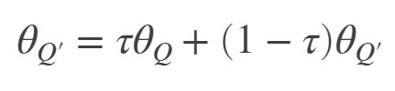
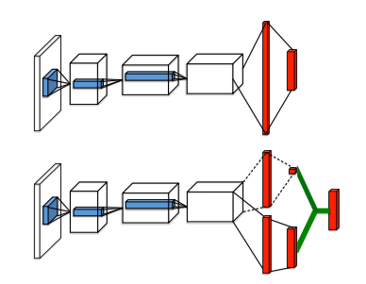
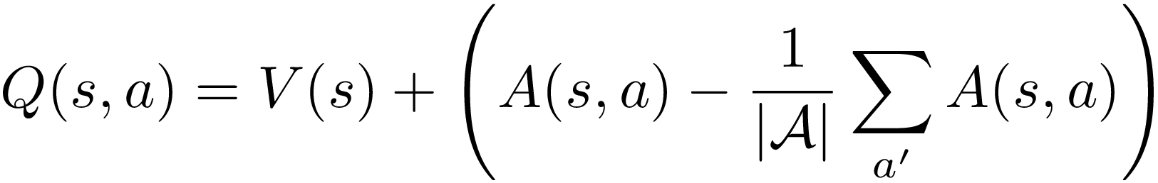
Extensions to DQN
Double DQN
1
policy network choose action for next state
target network evaluate the Q value for this action
2
Target network update
Smoothing/Soft update
Dueling DQN
3
advantage for each action
average advantage
state value
Notes:
Update the target parameters at every time step using smoothing factor τ

Slide 12
Training of DQN Agent
DQN Agent
Duelling Double DQN
policy network + target network
Discrete action space in DQN → 10 actions
Training session
1500 - 2000 episodes, each episode 500 time steps
Exploration technique: epsilon-greedy
Evaluation criteria: total reward, average reward per episode
Notes:
DQN agent with a critic representation based on the observation and action specifications from the environment. DQN is trained in environments with continuous observation space and discrete action space in the CartPole env.

Slide 13
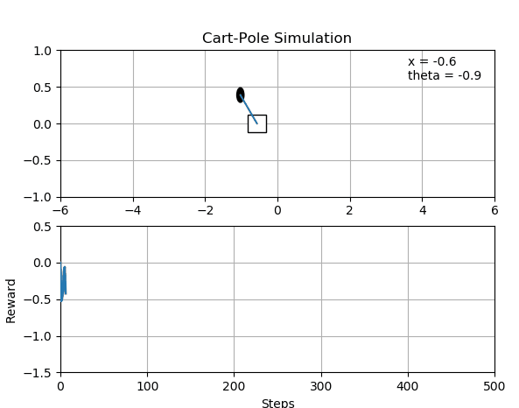
Results

Slide 14
Comparison & Discussion

Slide 15
Comparison
iLQR
DQN
using system dynamics
continuous state and action space
closed-form solutions
converge fast by exploiting hessians
not too applicable for complex systems
model-free, value-based function approximator
discrete action space
longer training time
debugging DQN = hyperparameter tuning
converge ≠ global minima

Slide 16
Discussion
Search the state-action space for optimum:
Optimal control -- guided by system dynamics
Model-based RL -- guided by “learned/estimated” system dynamics
Model-free RL -- no guidance (strategies/heuristics)
more complex model ← more information → easier to train
final performance relies on this trade off

Slide 17
Thanks!

Slide 18
Backup

Slide 19
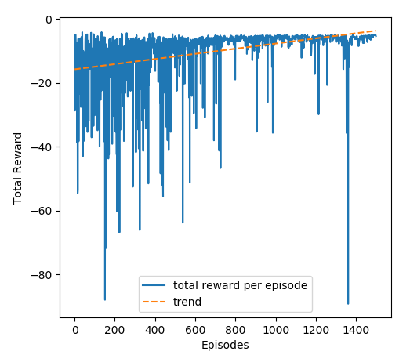
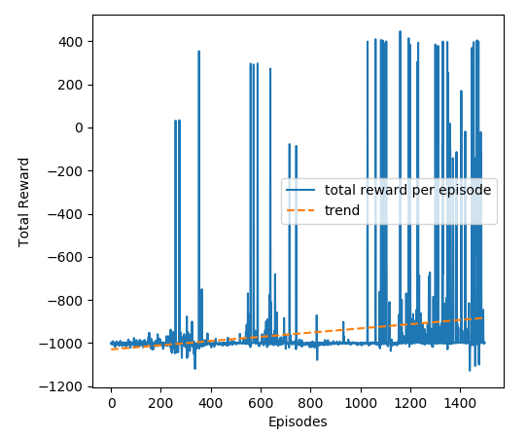
DDQN with Dueling
+penalty if episode terminate
total episodes: 1500 target network update: 100
time steps: 500 replay memory: 10000
minibatch size: 256 training time: 587.248 s
total episodes: 1500 target network update: 10
time steps: 500 replay memory: 10000
minibatch size: 128 training time: 857.346 s

